Slide 1

PRE-BID MEETING
PROVISION OF GREEN TECHNOLOGY SOLUTIONS TO MOYALE AND BUSIA BORDER MARKETS.
08 AUGUST 2026
Notes:
Change cover photo. See attached.

Slide 2
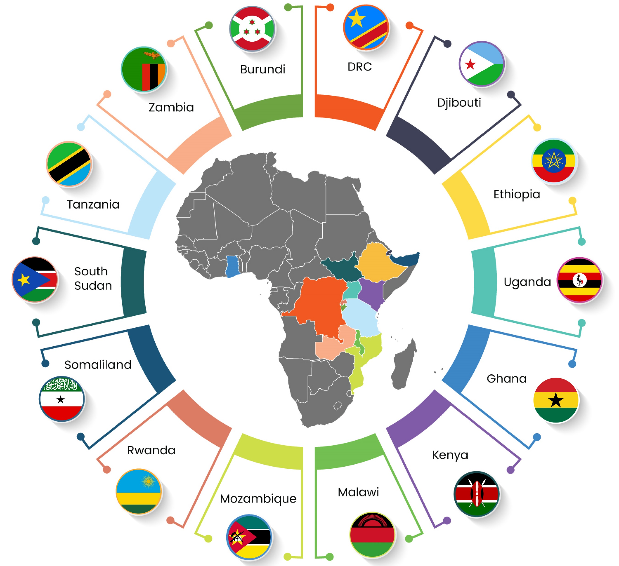
Presentation Content
Introductions
About TradeMark Africa
Processs Highlights – Technical
Tender highlights - Procurement
Environment & Social Safeguards highlights
Q&A

Slide 3
About TradeMark Africa
TradeMark Africa (TMA) is a leading African Aid-for-Trade organisation, founded in 2010, with a mission to grow intra-African trade, increase Africa’s share in global trade, and make trade more pro-poor and environmentally sustainable. Our focus on reducing the cost and time of trading across borders through enhanced trade policy, better trade infrastructure, standards that work for businesses, greater use of digital innovations and a focus on creating trade access for vulnerable groups, has contributed to substantially lower cargo transit times, improved border efficiency, and reduced trade barriers. TMA has expanded in recent years to operate in 14 countries across East, West and Southern Africa as well as the Horn, with registration underway in a further six countries. TMA operates on a not-for-profit basis and is funded by 12 institutional and philanthropic development partners. TMA works closely with regional and continental organisations, national Governments, the private sector and civil society organisations to deliver results that drive shared prosperity and reduce poverty.
For more information, please visit www.trademarkafrica.com

Slide 4
Assignment Overview
Design, supply, install, test, commission and hand over solar-powered cold room hubs.
Provide training, O&M support, manuals and as-built documentation.
Delivery period: 6 weeks from contract signature.

Slide 5
Mandatory Compliance Checklist
Certificate of Incorporation; Tax Compliance Certificate; Power of Attorney; JV Agreement (if applicable); Signed Supplier Code of Conduct; Conflict of Interest Form; Attendance Certificate; NCA Registrations; Food Hygiene License; Product catalogues and manufacturer authorizations (where applicable); Current licenses and statutory registrations.

Slide 6

Technical Submission Checklist
Technical Compliance Schedule with deviations declared.
Cooling load calculations and PV/Battery sizing.
Single line diagrams, earthing and protection schedules.
Methodology, HSE Plan, QA/QC Plan.
Commissioning plan, warranty and maintenance plan.

Slide 7
Minimum Technical Design Requirements
Cold RoomApprox. 5.9m x 2.3m x 2.3m75mm PU insulated panels0°C to +10°C
Refrigeration UnitMonoblock systemMinimum 4.5kW cooling capacity
Solar PVMinimum 30kWp
BatteryMinimum 100kWh usable LiFePO4HV System >150VDC

Slide 8
TENDER/BIDDING
HIGHLIGHTS

Slide 9

Key Procurement Compliance
Technical and Financial proposals MUST be separate PDF files.
Both proposals MUST be password protected.
No financial information in the Technical Proposal.
Submit before 27 July 2026, 11:00 AM (Kenya Time).
Late submissions are not accepted.

Slide 10
Lessons from Previous Evaluation
Many bidders copied the ToR instead of demonstrating methodology.
Several omitted required technical specifications.
Drawings submitted without supporting calculations.
Insufficient evidence of similar assignments.
Failure to demonstrate compliance resulted in non-responsiveness.

Slide 11
Clarifications
Clarifications only through Procurement procurement@trademarkafrica.com.
Tender document and issued addenda prevail over presentation.
Verbal responses are not binding.

Slide 12
Environmental and Social Safeguarding

Slide 13
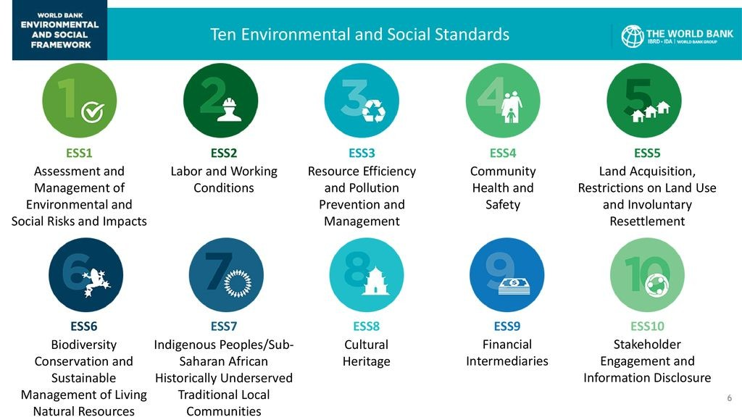
TMA has adapted the World Bank’s ESF that sets forth the 10 ESSs and this applies to all its projects.
TMA expects that all its projects will not bring harm to the environment and society. Further, the projects should improve the net well-being of the people

Slide 14
QUESTIONS?

Slide 15
Bidders are evaluated on demonstrated compliance. Generic statements, copied ToR text, drawings without specifications, or unsupported claims will not be considered evidence of compliance

Slide 16


