Slide 1


PRE-BID MEETING
CONSULTANCY SERVICES TO UNDERTAKE NEEDS ASSESSMENT, DETAILED ENGINEERING DESIGN, AND PREPARATION OF TENDER DOCUMENTS FOR THE REHABILITATION, MODERNIZATION, AND CONSTRUCTION OF PRIORITY FACILITIES ALONG THE ABIDJAN–LAGOS CORRIDOR: TENDER NUMBER: PRQ20251432
16 JUNE 2026
Notes:
Change cover photo. See attached.

Slide 2
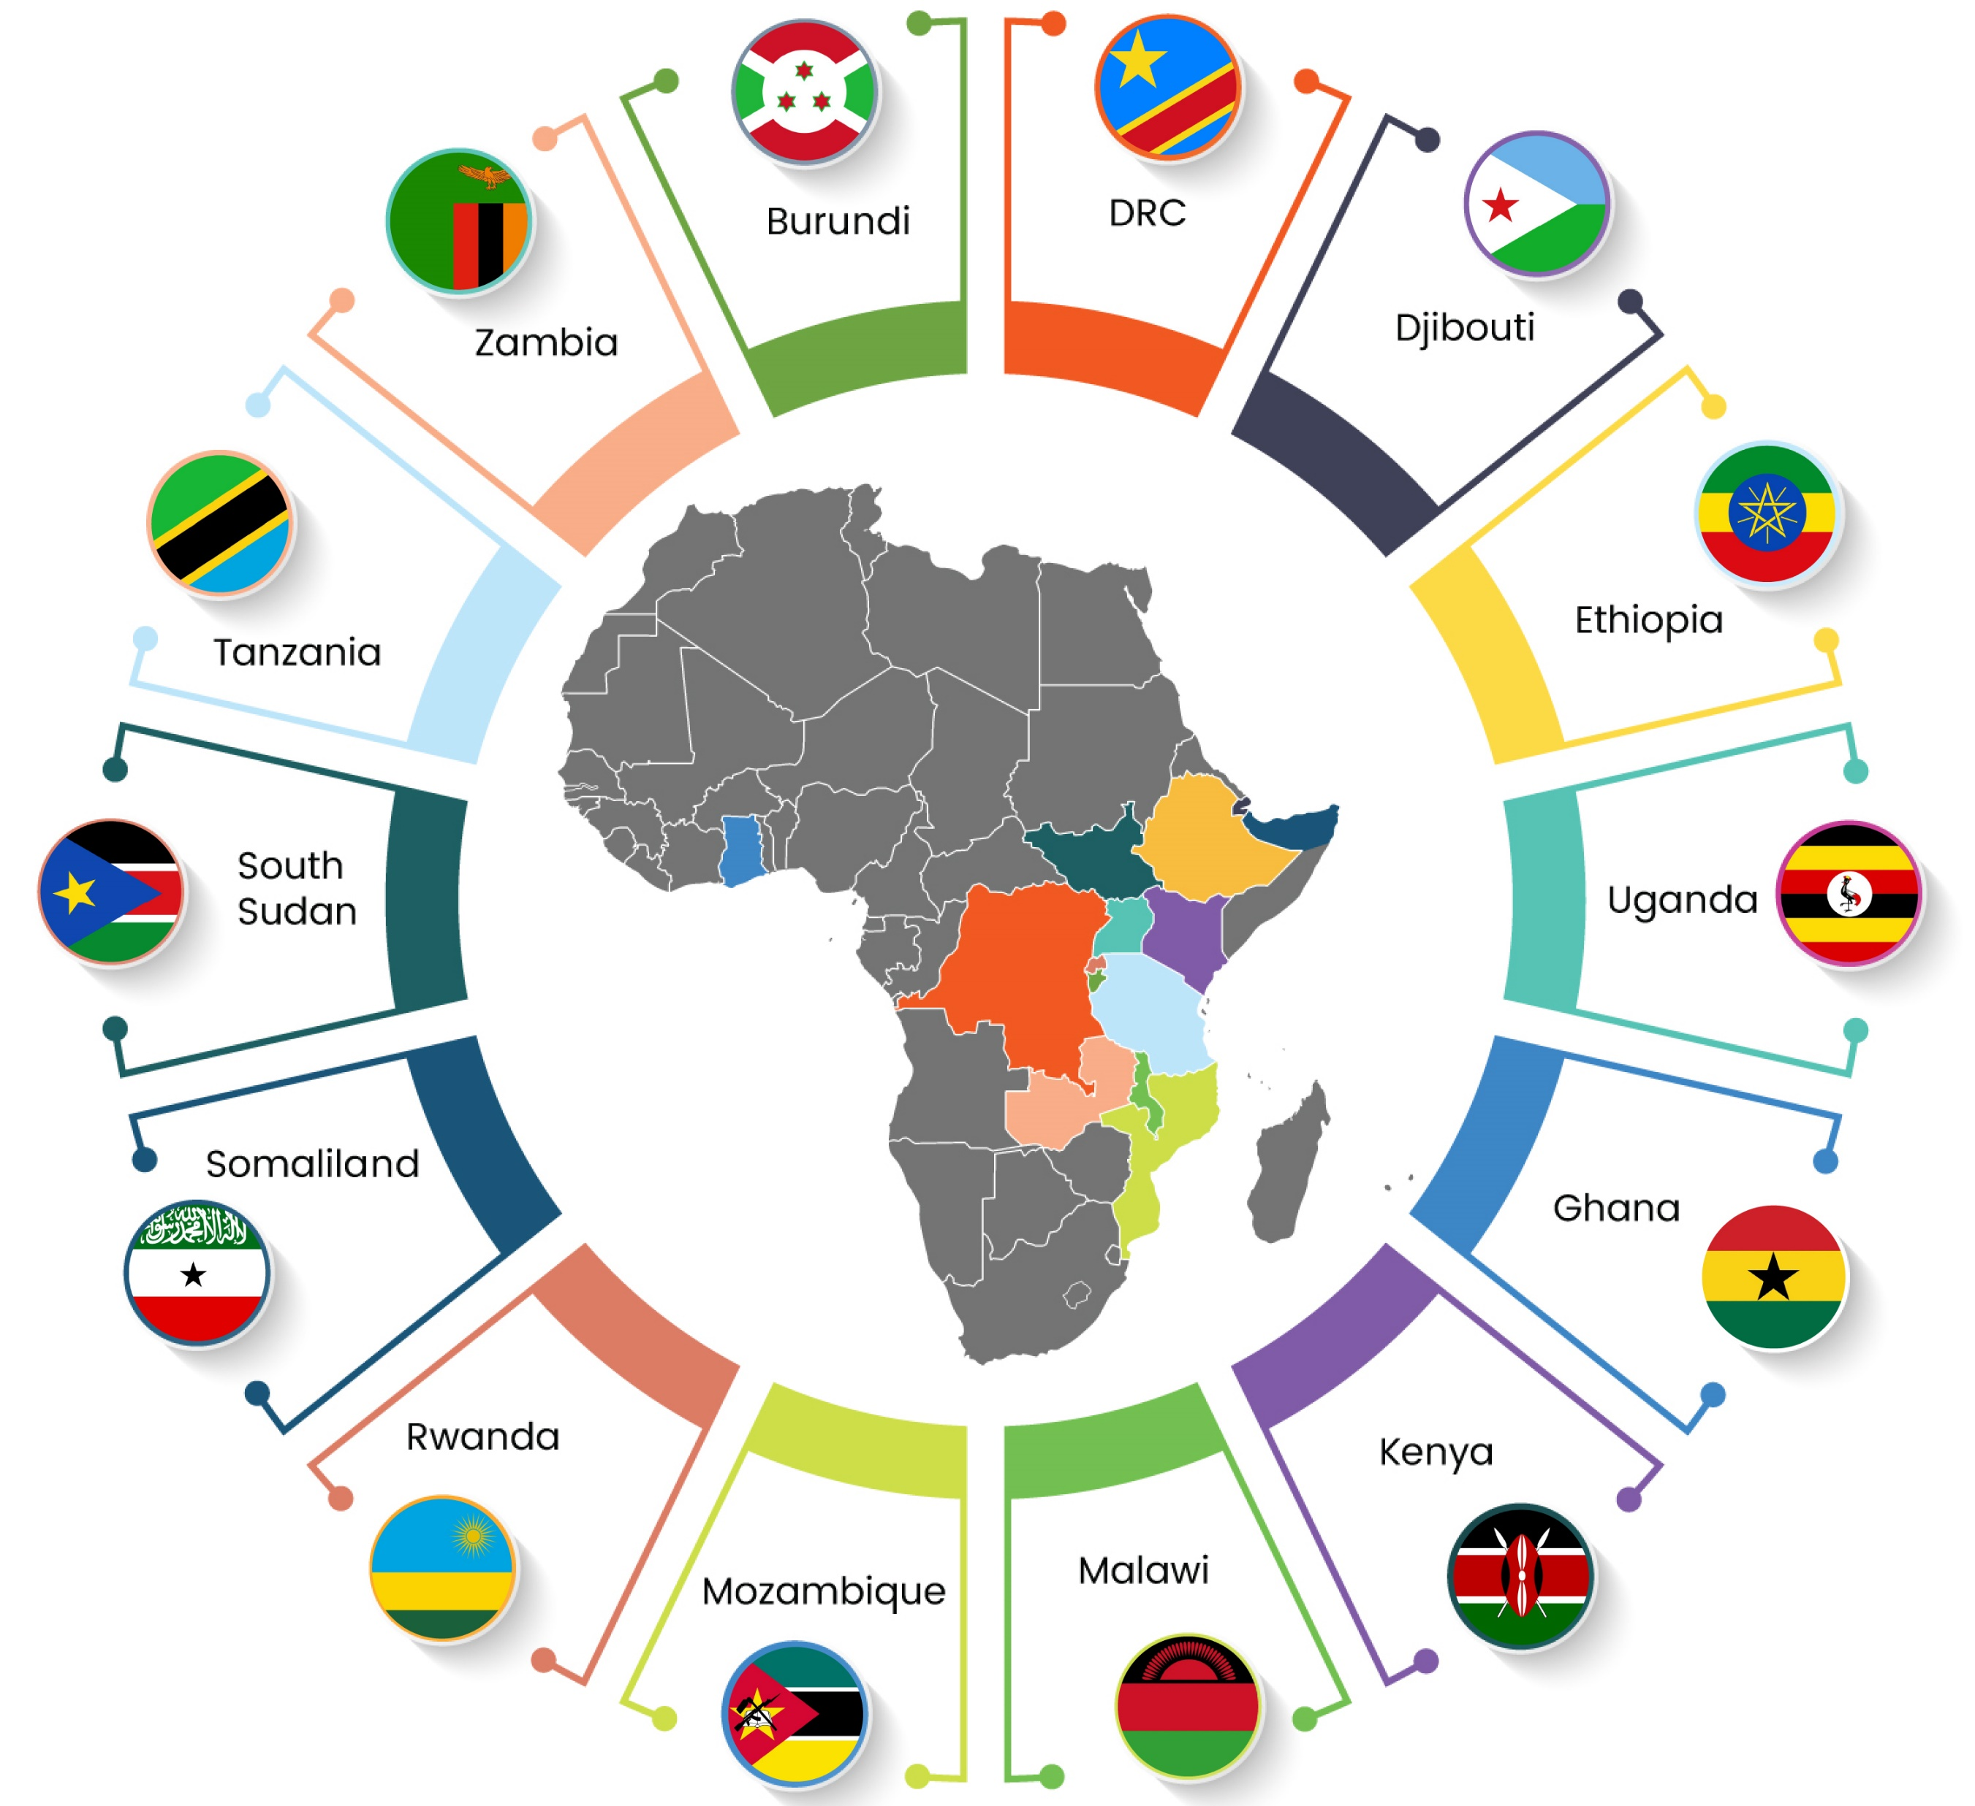
Presentation Content
Introductions
About TradeMark Africa
Processs Highlights – Technical
Tender highlights - Procurement
Environment & Social Safeguards highlights
Q&A

Slide 3
About TradeMark Africa
TradeMark Africa (TMA) is a leading African Aid-for-Trade organisation, founded in 2010, with a mission to grow intra-African trade, increase Africa’s share in global trade, and make trade more pro-poor and environmentally sustainable. Our focus on reducing the cost and time of trading across borders through enhanced trade policy, better trade infrastructure, standards that work for businesses, greater use of digital innovations and a focus on creating trade access for vulnerable groups, has contributed to substantially lower cargo transit times, improved border efficiency, and reduced trade barriers. TMA has expanded in recent years to operate in 22 countries across East, West and Southern Africa as well as the Horn. TMA operates on a not-for-profit basis and is funded by 12 institutional and philanthropic development partners. TMA works closely with regional and continental organisations, national Governments, the private sector and civil society organisations to deliver results that drive shared prosperity and reduce poverty.
For more information, please visit www.trademarkafrica.com

Slide 4
Project Background: Assignment Objectives
The objective of the consultancy is to provide professional engineering services for the preparation of designs and supervision of civil works to ensure that infrastructure investments are implemented efficiently, safely, and in accordance with approved technical standards.

Slide 5
Scope of the assignment
The Consultant shall provide professional engineering services covering design, procurement support, construction supervision and post-construction services for infrastructure improvements at selected border crossings and logistics hubs along the corridor.
The assignment will be implemented in the following phases.
1. Engineering Surveys and Detailed Design (6 Months)
Site Assessment and Surveys
The Consultant shall:
Conduct site reconnaissance visits and stakeholder consultations

Slide 6

Scope of the assignment
Undertake topographical and engineering surveys
Carry out geotechnical investigations where necessary
Assess existing infrastructure conditions
Analyse truck traffic circulation and operational requirements
Identify constraints related to land availability, utilities, drainage, safety and security.
Environmental and Social Screening
The Consultant shall undertake preliminary environmental and social screening to identify potential impacts and propose mitigation measures.

Slide 7
Scope of the assignment
The Consultant shall prepare a simple Environmental and Social Mitigation Response Matrix summarizing:
Potential environmental and social risks
Mitigation measures
Responsible parties
Monitoring indicators.
The cost for the mitigation measures and Environmental permits (where applicable) should be included in the bill of quantities.
Detailed Engineering Design
The Consultant shall prepare designs for:
Truck Parking Areas and Internal Circulation Roads

Slide 8
Scope of the assignment
Pavement design for heavy truck loads
Circulation layouts and turning radii
Drainage systems
Road markings and signage
Lighting and safety measures.
Sanitary Facilities
Toilets and shower facilities
Water supply systems
Wastewater treatment systems.

Slide 9
SCOPE OF ASSIGNMENT
Truck Waiting Areas and Secured Border Control Zones
Truck holding areas
Border inspection zones
Security fencing and access control
Lighting systems.
Axle Weighbridge Civil Works
Weighbridge foundations
Axle load scale and accessories
Control platforms and housing
Approach roads and drainage.

Slide 10
Scope of the assignment
Safety and Security Systems
Security lighting systems
CCTV surveillance systems
Access control systems
Electrical connections and mounting infrastructure.
Design solutions shall be cost-effective, climate-resilient and adapted to heavy truck operations typical of corridor logistics infrastructure.
2. Preparation of Tender Documentation
The Consultant shall prepare tender documentation including:
Detailed engineering drawings
Technical specifications

Slide 11
Scope of the assignment
Bills of Quantities (BOQs)
Cost estimates
Construction schedules
Technical specifications for security systems
3. Procurement Support
The Consultant shall support TMA during procurement by:
Participating in pre-bid meetings
Responding to technical queries from bidders

Slide 12
Scope of the assignment
Supporting clarification of design issues
Assisting in the technical evaluation of bids.
4. Construction Supervision (12 Months)
The Consultant shall supervise construction works and perform the role of the Engineer in accordance with FIDIC Conditions of Contract for Construction (Red Book 2017).
Responsibilities include:
Reviewing contractor work programmes
Reviewing method statements and shop drawings
Inspecting works and materials

Slide 13
Scope of the assignment
Monitoring construction progress and quality
Verifying quantities of completed works through joint measurement
Certifying interim payment certificates
Managing variations and change orders
Monitoring implementation of environmental and social mitigation measures
Ensuring compliance with health and safety requirements.

Slide 14
Scope of the assignment
5. Defects Notification Period (12 Months)
During the Defects Notification Period, the Consultant shall:
Conduct periodic inspections of completed works
Identify defects and notify the Contractor
Monitor rectification of defects
Verify completion of remedial works
Issue the Performance Certificate.

Slide 15
TENDER/BIDDING
HIGHLIGHTS

Slide 16

Basic/ Administrative requirements:
The bid submissions shall be in a non-editable version (PDF).
Please note that the maximum size of each email with attachments must not exceed 5MB. The Technical and Financial proposal shall be submitted as two separate documents in PDF format, in the same email or separate mails, and must be password protected.
Timely bid submission; on or before
Monday 29th June 2026 No Later Than 1400HRS CDI TIME. One-minute delay will not be accepted.

Slide 17
Bidding Documents:
The Bidding Documents consist of the following: -
Part I – Bidding Procedures
Section I – Instructions to Consultants (ITC)
Part II – Technical Proposal
The technical proposal shall not include any financial information. The Inclusion of any financial information shall lead to the proposal being declared non-responsive.
The technical proposal MUST be in PDF and password protected.
Part III - Financial Proposal
Currency of Proposal – United States Dollars
The contract shall be domiciled in Ghana hence Ghana taxes apply
Part IV – Conditions of Contract
TMA Code of Conduct – ( Supplier code of conduct)
Appendices

Slide 18
Bid Evaluation Criteria:
Evaluations will follow process below:
Phase 1: Evaluation of qualifications and eligibility (pass/fail)
This phase verifies compliance with mandatory requirements. Bidders must meet all criteria to proceed to phase 2. Failure in any area will result in disqualification.
  Legal registration and good standing (e.g., valid business licence, tax compliance certificate).
  Power of attorney authorising the signing of the bid. This must be authenticated by a Notary Public, Commissioner of Oaths or any other authority legally competent to attest such documents under the laws of the bidder’s country of registration.
  Signature of a joint venture agreement, if the Consultant is a joint venture.
  A signed TradeMark Africa Supplier Code of Conduct (attached Section 5)
Phase 2: Technical evaluation (scored out of 100 points)
Only bidders who have passed phase 1 will be evaluated here. Proposals are scored based on the criteria below. A minimum score of 70% (70/100) is required to qualify for phase 3. The evaluation committee will assess the quality, relevance and compliance of the proposal with the terms of reference.
Phase 3: Financial evaluation (out of 30 points)
The financial proposals of technically qualified bidders (from phase 2) will be opened and scored out of 30 points per IC 27.1

Slide 19
Important dates:
Placement date: - 08th June 2026;
Pre-bid conference: - 16th June 2026, 11:00 AM , CDI Time
Last clarification seeking date: Friday, 19th June 2026;
Submission date: - Monday, 29th June 2026 2:00 PM CDI time;
For clarification, please address them address procurement@trademarkafrica.com.

Slide 20

Evaluation of bids & NEGOTIATIONS:
The evaluation process shall be conducted as follows: -
Financial proposals will be assessed based on the lowest evaluated substantially responsive bid.
The bidder with the lowest evaluated cost will be considered for award, subject to post-evaluation negotiations.
TMA may negotiate with this bidder to confirm cost reasonableness, value for money, and clarity on the technical proposal, including the proposed team of experts (per TOR).
Negotiations may cover pricing, payment terms, and value-added services, ensuring quality standards and cost-effectiveness are maintained.
If negotiations fail within a reasonable timeframe, TMA reserves the right to terminate discussions and invite the next lowest evaluated responsive bidder.

Slide 21
Additional Information:
Note:
Bidders are encouraged to engage their tax advisors for Tax obligation and related advice.
Non-attendance at the pre-bid and site visit meeting will not be a cause for disqualification of a Bidder.
Any false information in the bid submission will lead to Automatic disqualification.
NOTE: In case of misrepresentations, the information in this pre bid presentations does not replace tender document. The Tender document & any clarifications & Addendum issued are supreme reference points.

Slide 22
Environmental and Social Safeguarding

Slide 23
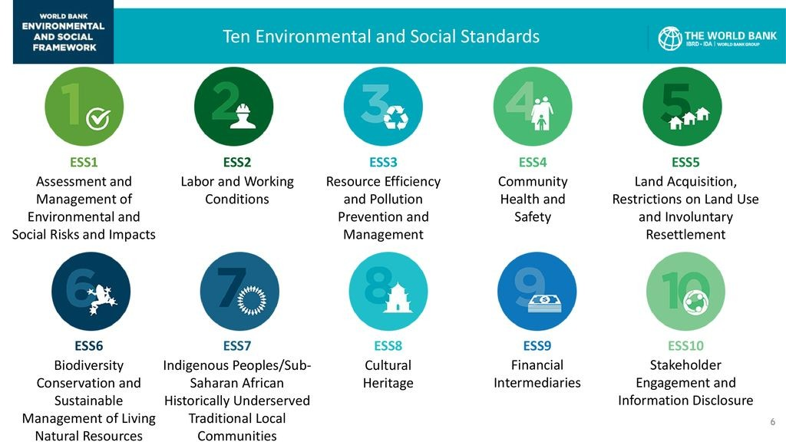
TMA has adapted the World Bank’s ESF that sets forth the 10 ESSs and this applies to all its projects.
TMA expects that all its projects will not bring harm to the environment and society. Further, the projects should improve the net well-being of the people

Slide 24
Key environmental and Social standards (ESS) for the QA/QC
(not exhaustive):
ESS 1 – Assessment and Management of Environmental and Social Risks and Impacts
ESIA are to be prepared for any project that has potential of bringing harm to the environment or social set-up of the project footprint. TMA policies require ESIA for all infrastructure projects.
ESS 2 - Labor and Working Conditions
OHS matters must be in place
GRM to be set up including to address SEAH issues
Compliance with national laws (e.g. wages/salaries, allowable age)
ESS 3 – Resource Efficiency and Pollution Prevention and Management
Sustainable use of raw materials (including borrow pits)
Avoid/minimise project-related emissions & pollutants
Management of hazardous & non-hazardous waste

Slide 25
QA/QC issues
(not exhaustive) cont… :
ESS 4 – Community Health and Safety
Identify potential community exposure to project-related risks, and propose appropriate mitigation
Risk and Incident management: appropriate risk management framework(s) for the project including incident/issue management e.g. practical and accessible GRM, escalation of risks, etc.
ESS 5 – Land Acquisition, Restrictions on Land Use and Involuntary Displacement
Identify if project will result in involuntary displacement of people; evidence document of land ownership to be included in reporting.
ESS 6 – Biodiversity conservation and sustainable management of living natural resources
Project adjacent to a water resource (L. Albert) that should be protected. (Periodic Water quality analysis etc.)
ESS 10 – Stakeholder engagement and information disclosure
Stakeholder engagements have influenced the project designs

Slide 26
QUESTIONS?

Slide 27

info@trademarkafrica.com
www.trademarkafrica.com
TradeMark Africa
@TradeMarkAfrica
TradeMark Africa

