Slide 1
TradeMark Africa
Virtual Supplier Conference
Framework Contracting
TradeMark Africa Procurement Unit – 30 May 2024
Taveta, Kenya –Holili, Tanzania OSBP. Photo/TMA
Notes:
Photo: The first OSBP completed and operationalised by TMA. Interventions focused on reducing the time to cross borders such as supporting standards agency here have reduced testing turnaround time by 91% from 12 days to 1 day

Slide 2
WHO WE ARE
Aid-for-trade not-for-profit organisation founded in 2010
Our Mission
Our Vision
To increase sustainable and inclusive intra-African trade and exports to the rest of the world
Africa pioneering in sustainable and inclusive growth as a pathway to prosperity for all Africans

Slide 3
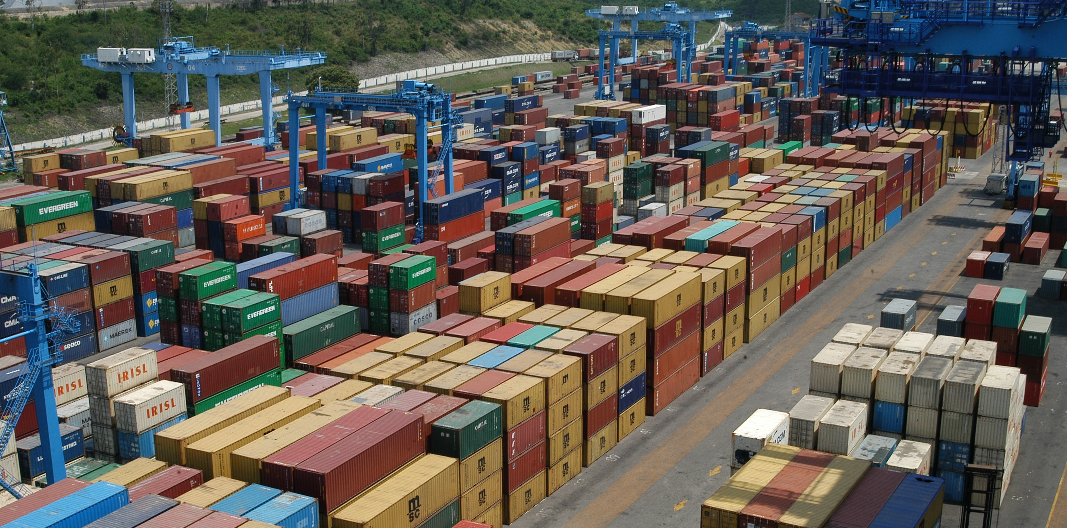
FUNDING
PARTNERSHIPS
DONORS
Investment of $1bn over the last 13 years
National Governments in all countries of operation, RECs, AfCFTA, AU, Private Sector bodies
AFD, Belgium, BMGF, Canada, Denmark, EU, Mastercard Foundation, Finland, Norway, Ireland, Netherlands, UKaid, USAID

Slide 4
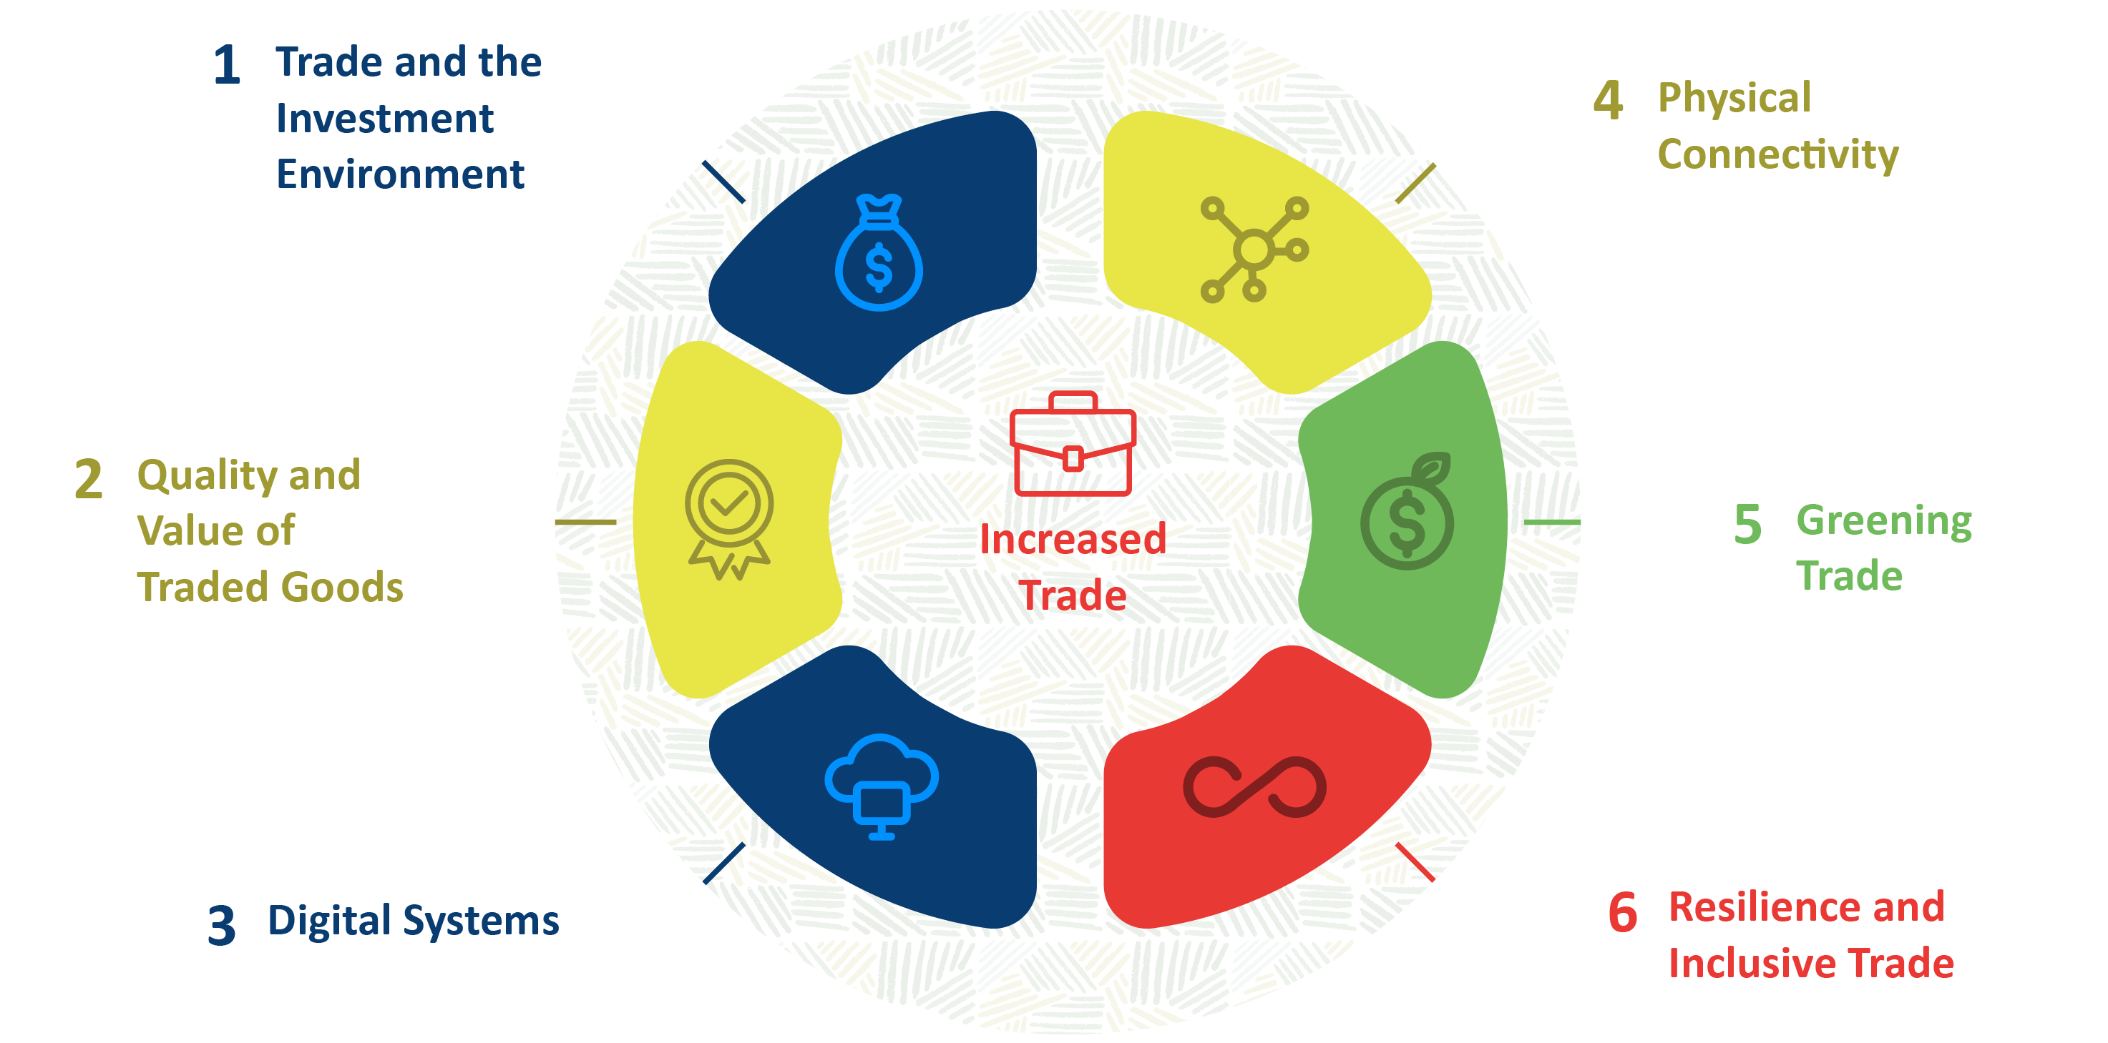
PORTFOLIOS

Slide 5
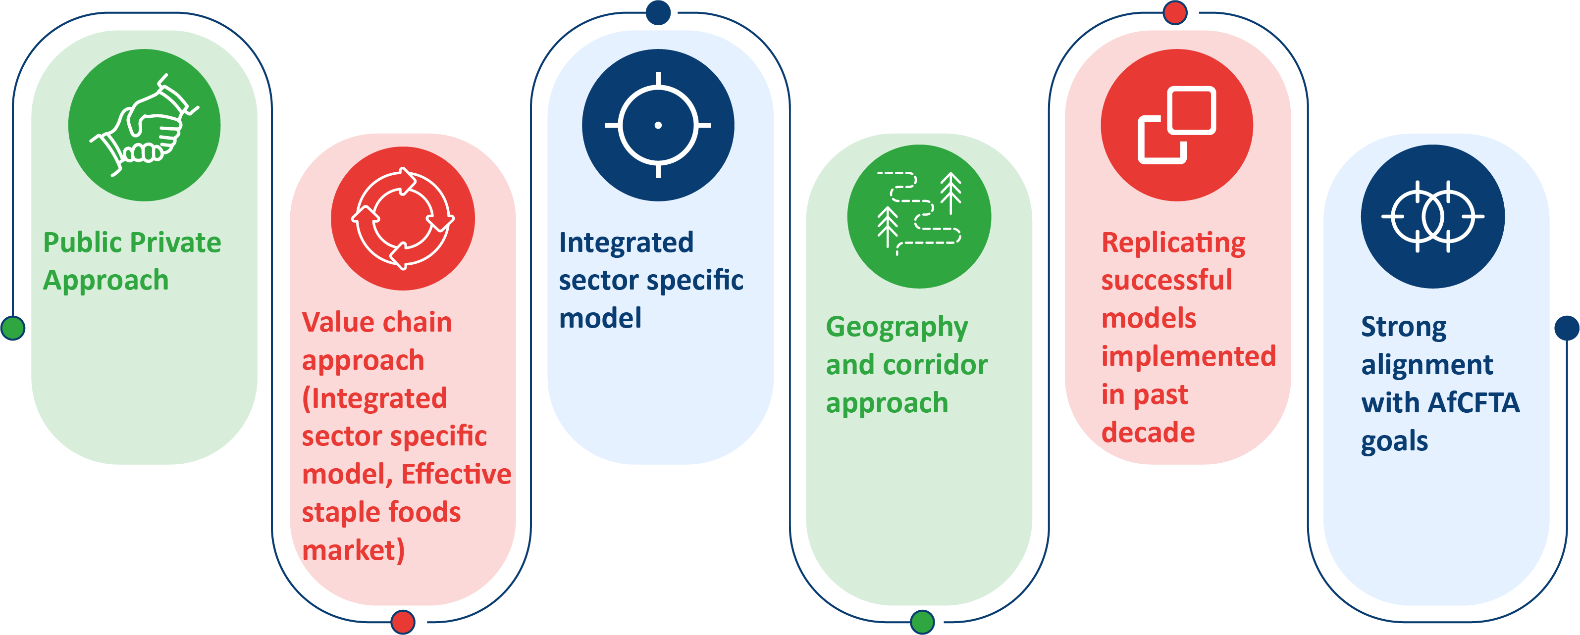
STRATEGY 3 APPROACH

Slide 6
Framework Agreements
TMA Definition of a Framework Agreement.
Benefits of Framework Agreements.
TMA Framework Agreement Thematic Areas.
Establishment of a Framework Agreement.
Call-offs from Framework Agreements.
Round-robin Approach.
Bid Preparation Tips.
Adherence to TMA Supplier Code of Conduct.
Upcoming Work.

Slide 7
Definition of Framework Agreements
In line with the TMA Procurement Procedures Manual, a "Framework Agreement" means "a list of a defined number of shortlisted suppliers in a relevant market, that may be established at regional and/or country level, for a specified period and may incorporate ‘Lots’ as appropriate.“
Framework agreements are a method by which goods, services and works can be procured efficiently and transparently to achieve value for money. Framework agreements, once established, provide several benefits when compared to traditional open, restricted, and direct processes, not least they provide a quicker route to market.

Slide 8
Benefits of Framework Agreements
Benefits for TradeMark Africa:
Administrative efficiency: Procurements are conducted with lower transaction costs and shorter lead times.
Bigger contracts and share of risks (security of supply): Use of frameworks encourages consolidation of requirements. In addition, having suppliers on call down contracts ensures security of supply.
Flexibility & process efficiency: Use of frameworks leads to higher uniformity and standardisation, better supplier understanding of procurement entity’s needs resulting in improved quality submissions.
Competitive pricing: Aggregating demand and repetitive use of frameworks leads to better pricing from supplier.

Slide 9
Benefits of Framework Agreements
Benefits for Suppliers:
Administrative efficiency: No need to prepare numerous lengthy proposals.
Higher chances of success: There is a higher chance of being contracted under framework contracting more so through the round-robin approach.
Improved relationship with the procuring entity: Supplier will develop a better understanding of procurement entity’s needs resulting in improved quality submissions. Th supplier will also get to know better the procuring entity’s working practices, preferences and procedures which are useful when bidding for future opportunities.

Slide 10
Framework Agreements Thematic Areas
TMA may establish Framework Agreements for the following thematic areas, which may change from time to time:
Infrastructure and Services.
Transport and Logistics Services.
Standards and SPS Services.
Improved Business Competitiveness.
Improved Trade Environment.
Green Trade.
ICT and Digital Trade Systems.
Monitoring, Evaluation, Learning and Knowledge Management.
Public Relations and Communications.
Corporate Services and Audit Services.

Slide 11
Establishment of Framework Agreements
For individual consultancy frameworks, TMA may request potential framework service providers to submit fee rates at the establishment of the frameworks.
TMA may add additional related works, services, or goods to the scope of the framework agreement as deemed appropriate at any time during the life of the framework.
TMA may open the framework by adding more suppliers through an initial competitive process and exclude non-performing suppliers from the framework list based on performance assessment.
Framework Agreement may be established at regional and/or country level, incorporating ‘Lots’ where necessary and appropriate to the relevant market.
The initial establishment and subsequent contracting from a framework agreement, may include a round(s) of pre-tender market engagement, prior to tenders being invited.
The initial establishment and subsequent contracting from a framework agreement may include a round(s) of negotiation, during the evaluation process and prior to contract award.

Slide 12
Establishment of Framework Agreements
BUSINESS INFOGRAPHIC
WRITE YOUR SUBTITLE HERE
Upon receipt of tenders, each shall be evaluated in accordance with the evaluation selection criteria as stated in the invitation to tender documents that shall include TMA’s supplier Code of Conduct form to be completed and submitted along with the offers.
At the conclusion of the evaluation process the defined number of suppliers, where it is possible, who achieve the highest score above the minimum pass mark based on the selection criteria shall be appointed to the framework agreement.
The advertisement shall, depending on the requirement, be published in the way in which TMA publishes tender adverts to invite tenders.

Slide 13
Call-offs from Framework Agreements
Once established, individual pieces of work will be required throughout the life of the framework agreement. For each individual piece of work a ToR/statement of requirements shall be issued.
01
02
Suppliers shall be permitted a reasonable period to submit tenders based on the complexity of the requirements.
For call off with mini competition, upon receipt of tenders, each shall be evaluated in accordance with the detailed evaluation award criteria published as stated at the time and shall include TMA’s supplier Code of Conduct form to be completed and submitted along with the tenders.
03
At the conclusion of the evaluation process, the individual pieces of work shall be awarded to the tenderer who achieves the highest overall score based on the award criteria and/or demonstrates compliance with the set evaluation criteria.
04

Slide 14
Round-robin approach
The "round robin" method of supplier selection systematically allocates procurement opportunities among framework suppliers in order from a list, ensuring that each gets a fair chance to bid before the cycle restarts.
This method promotes fairness and transparency, maintaining a competitive and unbiased procurement environment.

Slide 15
Round-robin approach
Where framework suppliers have provided fee rates (for individual consultants and input-based assignments), TMA shall ensure fair allocation of work to service providers (under the framework agreement) under a principle of rotation.
01
02
04
03
The budget for each individual assignment under this provision shall not exceed $250,000.

Slide 16
Bid Preparation Tips
1. Administrative management consulting firms.
1.1 Correct language (with translation/s where different language is used);
1.2 Timelines complied with;
1.3 Full response to tender requirements
1.4 Attachment of required documents as per the bid instructions such as:
1.4.1 Registration certificate/s;
1.4.2 Tax compliance/ registration certificates;
1.4.3 Professional registrations such as that for engineers, architects, environmentalists, accountants, supply chain experts, etc;
1.4.4 Power of attorney, TMA Supplier Code of Conduct; and
1.4.5 Audited accounts for the years requested.
1.5 Accurate sealing/ naming of bids/ password protecting; and
1.6 Timely submissions (no last-minute rush!).
www.trademarkafrica.com @trademarkafrica

Slide 17
Bid Preparation Tips
2. Technical & Post Award
2.1 Well detailed proposal:
2.1.1 Follow the guidelines detailed in the tender document.
2.1.2 Understanding of ToRs.
2.2 Evidenced based experience;
2.3 Excellent proposed team of experts/ personnel;
2.4 Compliant structure of bid;
2.5 Well arranged, titled and easy to read proposal;
2.6 Defined jargon where used;
2.7 Demonstrated creativity and uniqueness of the technical bid;
.
2.8 Signed CVs of proposed experts/ personnel alongside declaration by individual of her/ his CV not being used by any other firm within the same bid especially where cross- biding is barred;
2.9 Keen attention on high/ important technical requirements/ qualifications areas & scoring more;
2.10 Quality assurance of the bid;
2.11 Positive due diligence.
2.12 Accurate bid information.
2.13 Good performance (quality, cost, quantity, etc) on award of contract.
www.trademarkafrica.com @trademarkafrica

Slide 18
Adherence to TMA Supplier Code of Conduct
TMA Supplier Code of Conduct (“the Code”) sets out the minimum requirements and standards expected from all suppliers, tenderers and sub-contractors, when delivering projects and programmes. The Code covers areas that are central to a procurement and supply process such as value for money and governance, ethical behaviour and transparency, delivery chain management, observance of human rights, environmental and social safeguarding, organised crime and security. It also covers employment of forced and/or child labour, fraud and corruption, gifts and hospitality. consulting firms.
Fraud & Corruption
Safeguarding
Organised Crime
TMA has zero tolerance of fraud, corruption, misconduct. Bidders are informed that TMA will not accept gifts or offers for consideration of their tenders. Selection is based on merit. Unethical behaviour to be reported and delt with in accordance with the code.
When doing business with TMA suppliers are expected to:
▪Act responsibly & with integrity
▪Be transparent & accountable
▪Seek to improve value for money.
▪Demonstrate commitment to poverty reduction & TMA priorities.
TMA shall conduct a reasonable search of publicly available information to determine whether a supplier is suspected of any activity relating to terrorism, including terrorist financing, or organised crime.
www.trademarkafrica.com @trademarkafrica

Slide 19
Upcoming Work
The first batch of frameworks arising for various workstreams ranging from Trade Policy, Audit & Investigations, Supplies and Services for OSBP work to be advertised in June 2024.
Subsequent framework batches to be advertised as and when the requirements are determined and signed off internally for tendering.
Suppliers are advised to be on the look-out for these tenders on the TMA website, digital platforms like LinkedIn and on newspaper publications.

Slide 20
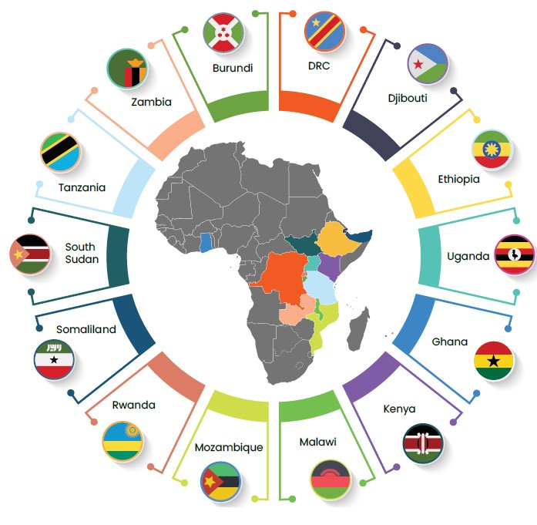
info@trademarkafrica.com
www.trademarkafrica.com
TradeMark Africa
@TradeMarkAfrica
TradeMark Africa

